Slide 1
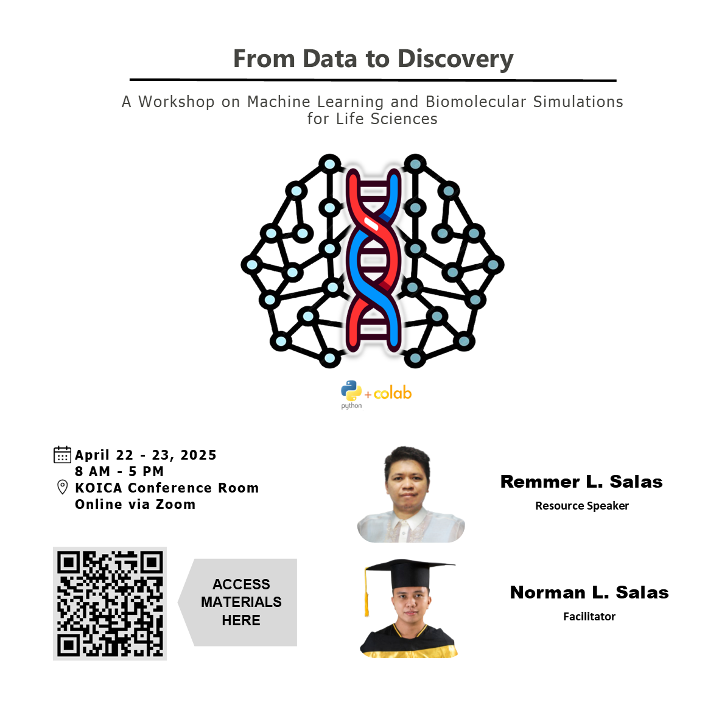

Slide 2
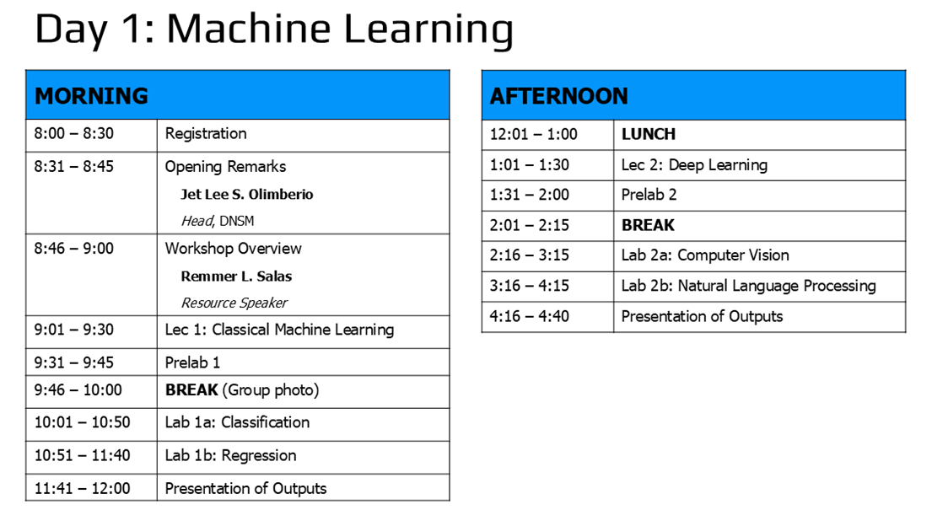

Slide 3
Classical machine learning
LECTURE 1
Remmer L. Salas
Chemistry Instructor
Department of Natural Sciences and Mathematics
Visayas State University

Slide 4
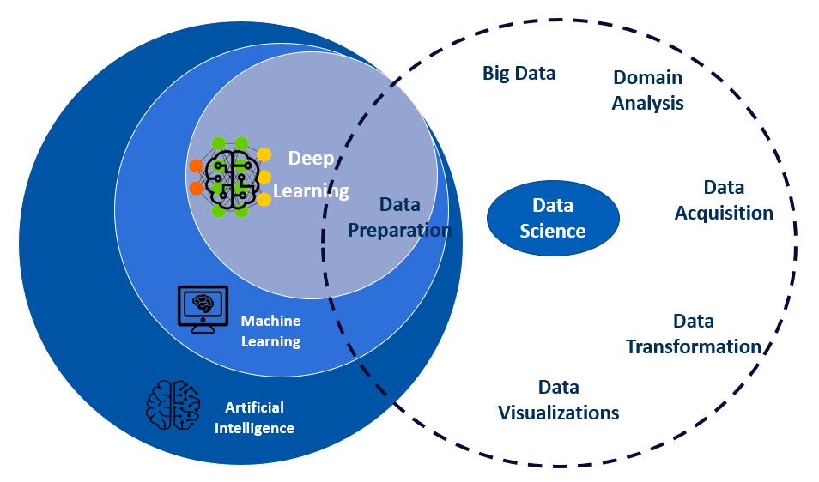
AI vs ML vs DL vs DS
AI – enables machines to mimic human behavior
ML – subset of AI; uses Stat to enable machines to improve with experience
DL – subset of ML; uses neural networks
DS – focus on extracting insights & making predictions

Slide 5
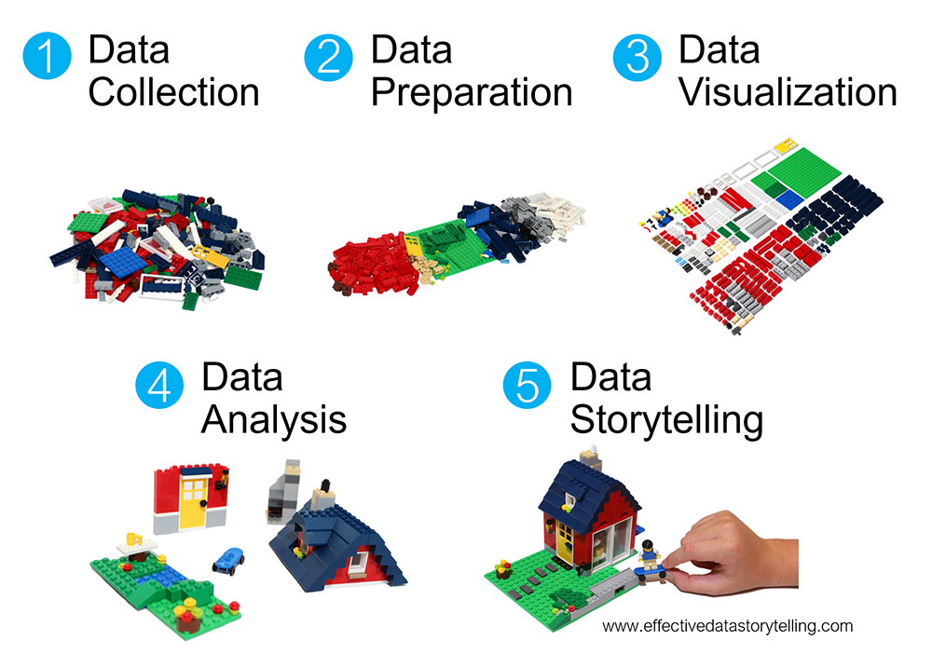
Partly, we are doing data science

Slide 6

DL is like a hammer
AI != Statistics

Slide 7
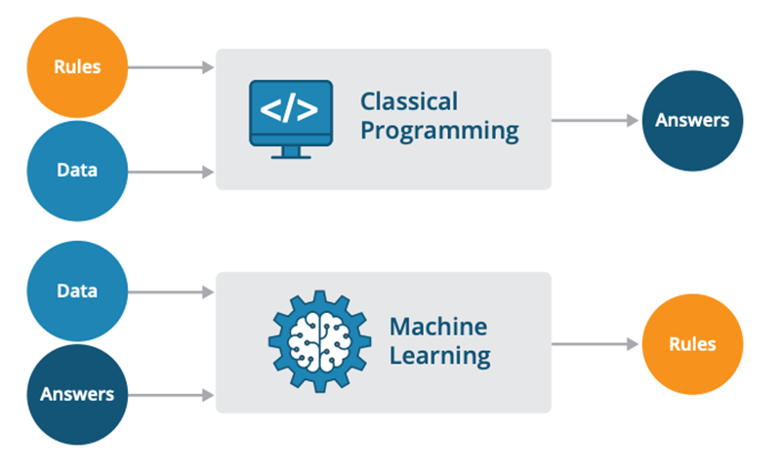
What is ML?
Labels
https://sravya-tech-usage.medium.com/traditional-programming-vs-machine-learning-e9bbed5e491c

Slide 8
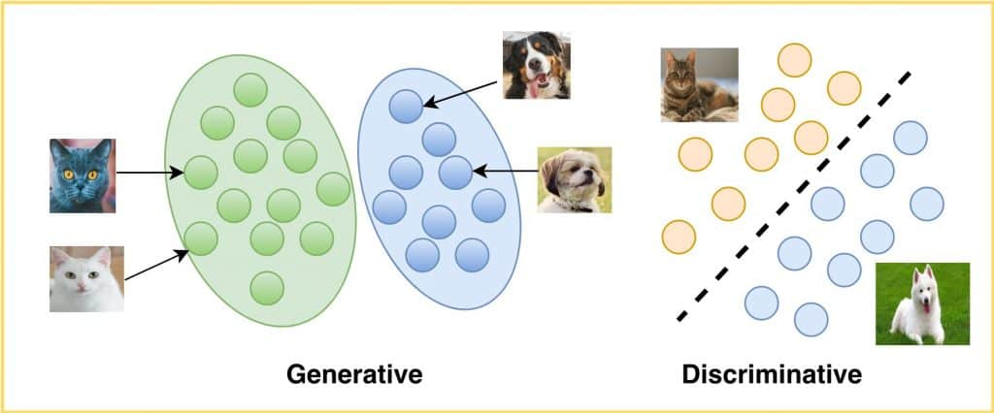
Types of ML
https://learnopencv.com/generative-and-discriminative-models/

Slide 9
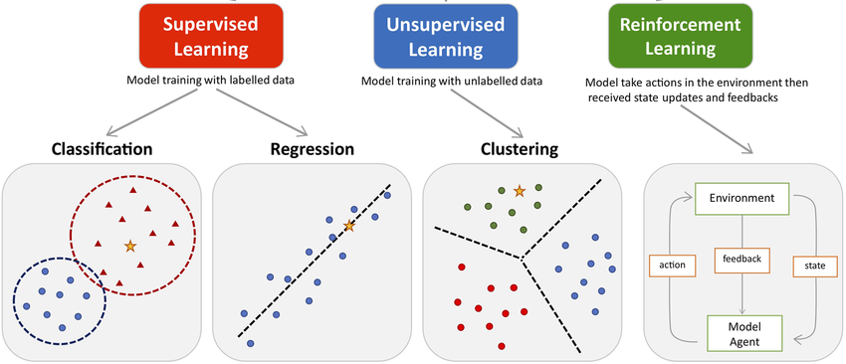
Types of ML
http://dx.doi.org/10.3389/fphar.2021.720694

Slide 10
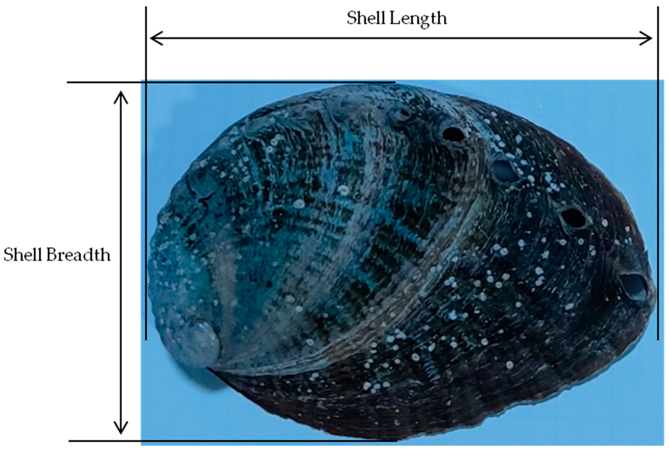
Regression
predicts a continuous numerical value
Simple linear regression:
y = w₁x + b
Age of abalone
Shell length
Shell diameter
Shell length
https://doi.org/10.3390/jmse9070707
Raschka et. al. 2022, ML w/ pytorch & scikit-learn

Slide 11
Regression
Multiple linear regression
y = w₁x₁ + w₂x₂
+ …w_{n}x_{n} + b
Age of abalone
Ex: Abalone dataset
Shell length
Shell diameter
Shell diameter
Shell length
https://doi.org/10.3390/jmse9070707
Raschka et. al. 2022, ML w/ pytorch & scikit-learn

Slide 12
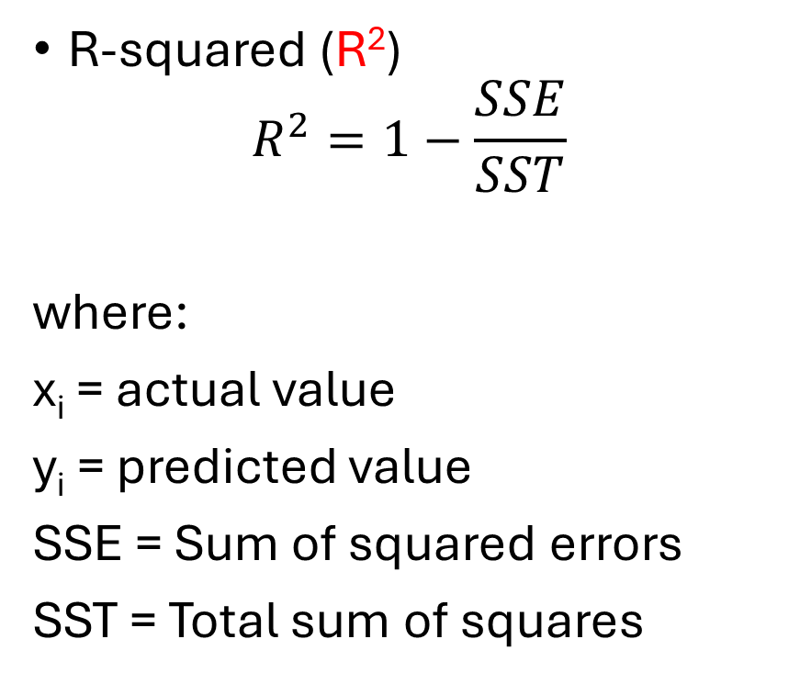
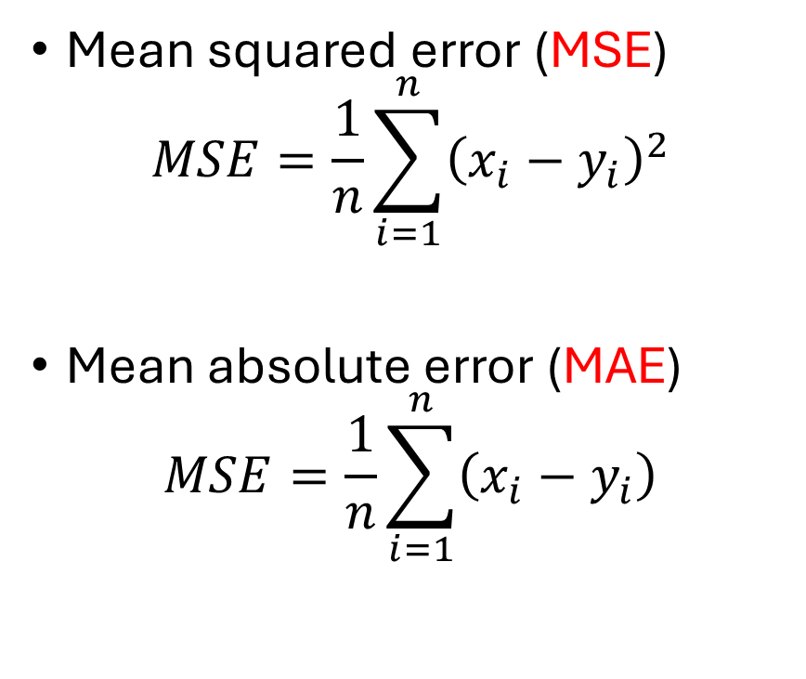
Metrics for regression
Mean squared error (MSE)
$$MSE=\frac{1}{n}\sum_{i=1}^{n}{{\left(x_{i}−y_{i}\right)}^{2}}$$
Mean absolute error (MAE)
$$MSE=\frac{1}{n}\sum_{i=1}^{n}{\left(x_{i}−y_{i}\right)}$$
R-squared (R²)
$$R^{2}=1−\frac{SSE}{SST}$$
where:
x_{i} = actual value
y_{i} = predicted value
SSE = Sum of squared errors
SST = Total sum of squares

Slide 13
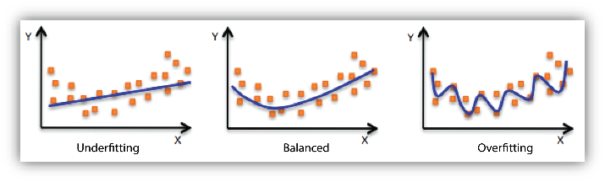
Underfitting vs overfitting
↑MSE (Train set); ↑MSE (Val set)
↓Acc (Train set); ↓Acc (Val set)
very ↓MSE (Train set) < MSE (Val set)
Acc (Train set) > Acc (Val set)
↓MSE (Train set) ≈ MSE (Val set)
Acc (Train set) ≈ Acc (Val set)
https://docs.aws.amazon.com/machine-learning/latest/dg/model-fit-underfitting-vs-overfitting.html

Slide 14
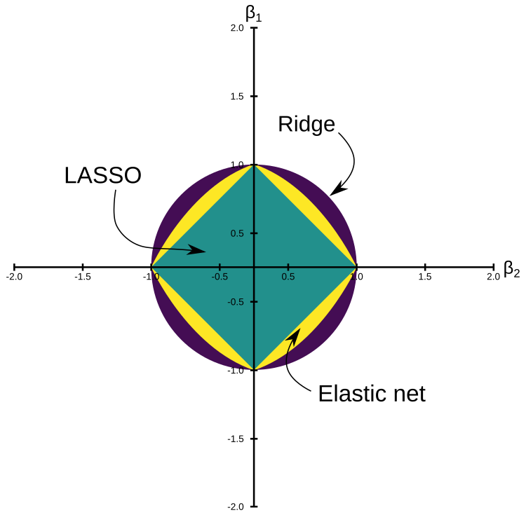
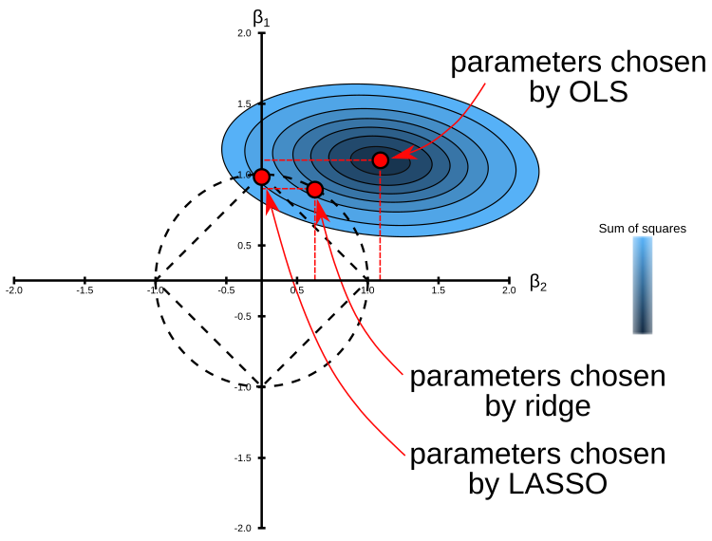
Regularization
prevent overfitting & improve generalization
(L2: weight sharing)
(L1: induces sparsity)
(compromise
bet L1 & L2)
OLS: Ordinary Least Squares
LASSO: Least Absolute Shrinkage & Selection Operator
https://livebook.manning.com/book/machine-learning-with-r-the-tidyverse-and-mlr/chapter-9/v-4/67

Slide 15
Additional terminologies
Ex: Iris dataset
Features:
Classical ML: handcrafted
DL: non-handcrafted
X = samples + features
y = class labels
Raschka et. al. 2022, ML w/ pytorch & scikit-learn

Slide 16

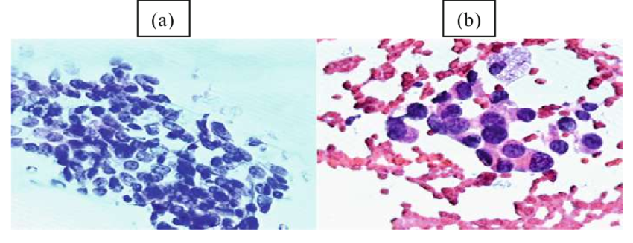
Classification: Logistic regression (logit)
predict the class label of a sample
Ex: Breast cancer dataset
1: Benign
0: Malignant
http://dx.doi.org/10.1007/978-3-030-36664-3_10
https://www.tpointtech.com/logistic-regression-in-machine-learning

Slide 17
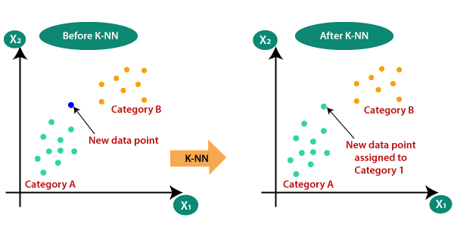
K-Nearest Neighbors (KNN)
A
https://www.tpointtech.com/k-nearest-neighbor-algorithm-for-machine-learning

Slide 18

Support Vector Machine (SVM)
https://www.tpointtech.com/machine-learning-support-vector-machine-algorithm

Slide 19
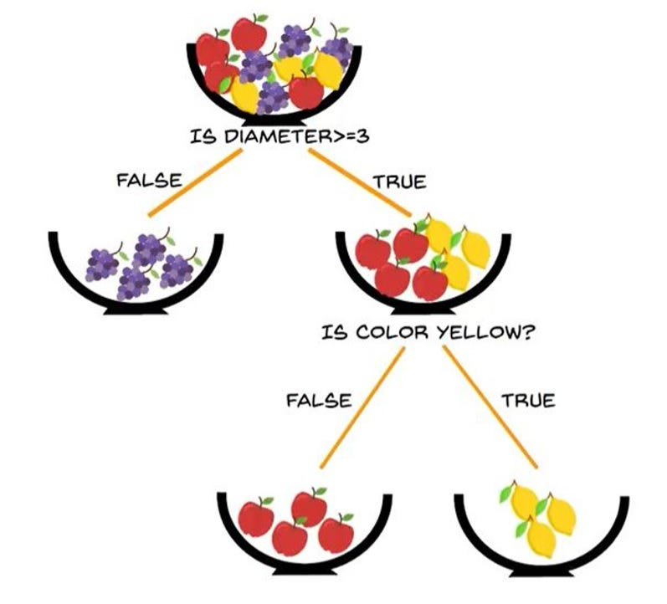
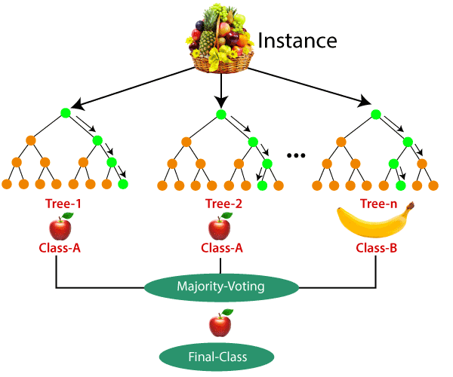
Decision Tree (DT)
Random Forest (RF)
Grapes
Apples
Lemons
https://medium.com/@rahulrastogi1104/decision-tree-regression-and-its-mathematical-implementation-c87352a8a2b0
https://medium.com/@zsalifu22/unveiling-the-power-of-random-forest-a-comprehensive-guide-with-practical-insights-and-code-16c744a030c1

Slide 20
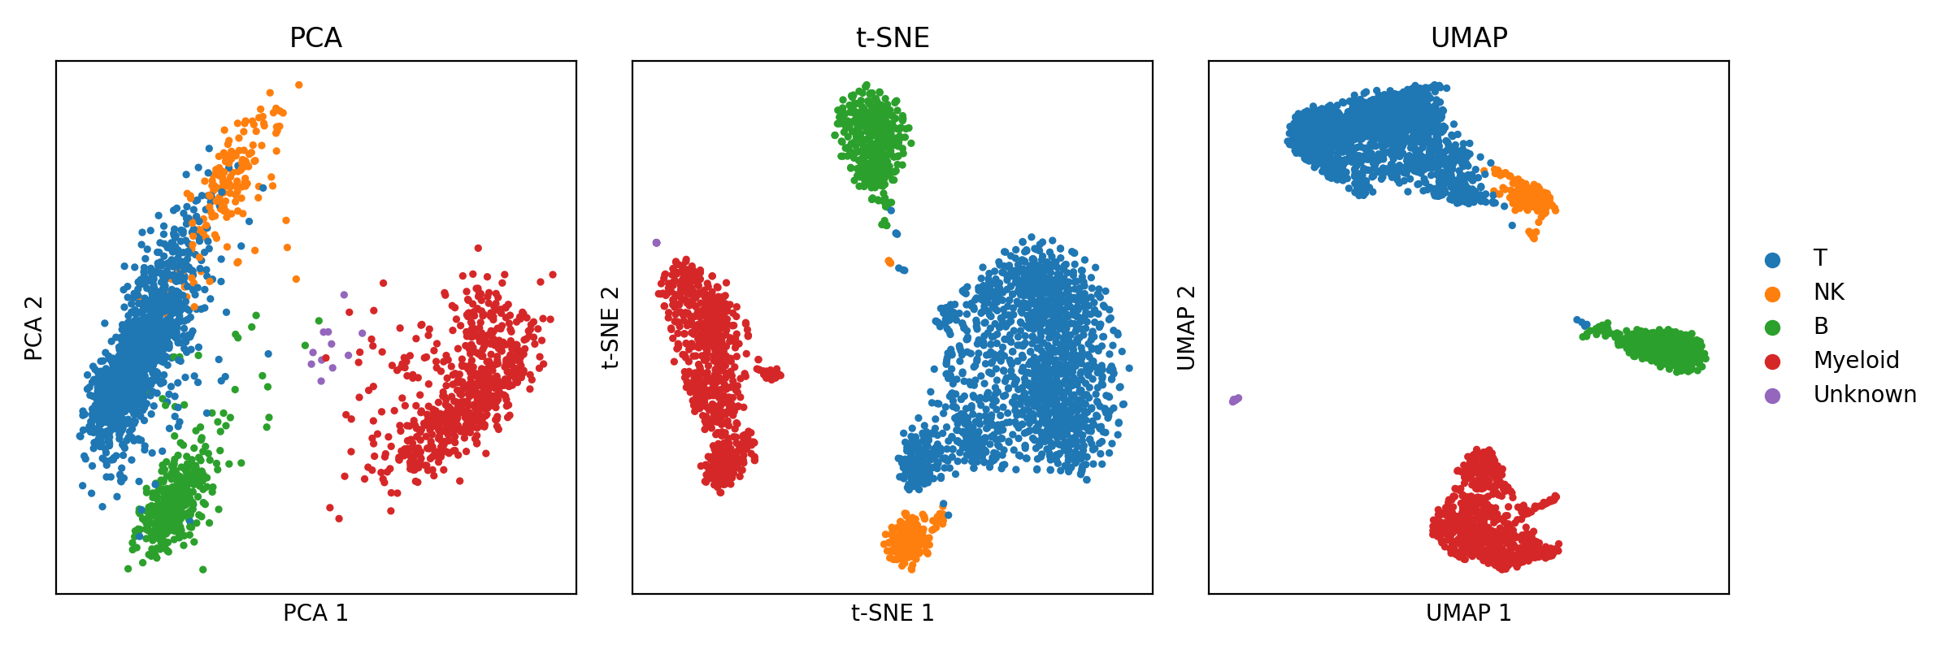
Unsupervised Learning
Method | Linear | Non-linear | Non-linear
Focus | Maximizing variance (global structure) | Preserving local structures | Preserving both local & global structures
Reproducibility | Very scalable & deterministic | Results may vary with different runs | More stable than t-SNE but less deterministic than PCA
https://mbernste.github.io/posts/dim_reduc/

Slide 21
Predictive modeling workflow
Raschka et. al. 2022, ML w/ pytorch & scikit-learn

Slide 22
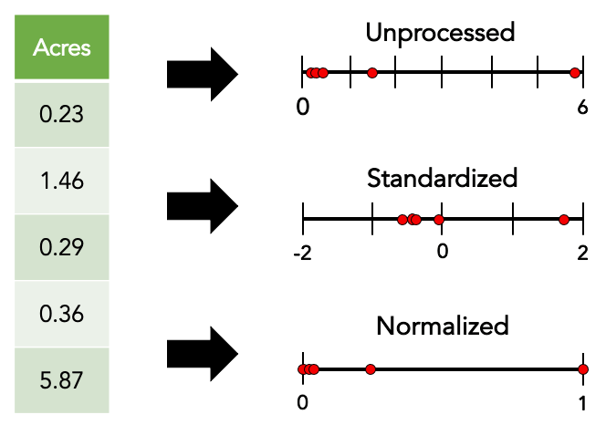
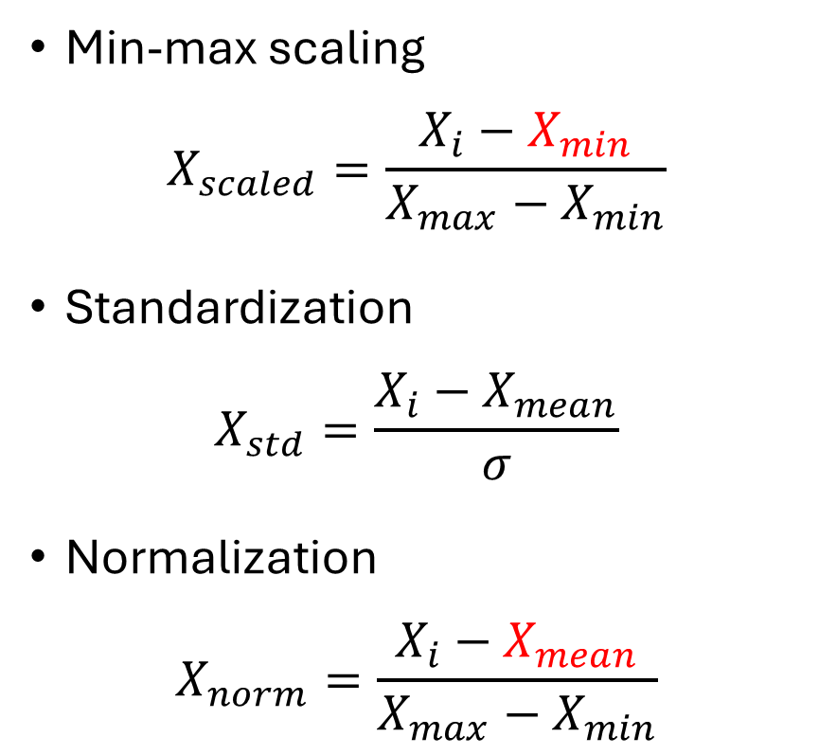
Feature scaling
Min-max scaling
$$X_{scaled}=\frac{X_{i}−X_{min}}{X_{max}−X_{min}}$$
Standardization
$$X_{std}=\frac{X_{i}−X_{mean}}{σ}$$
Normalization
$$X_{norm}=\frac{X_{i}−X_{mean}}{X_{max}−X_{min}}$$
?
?
https://thaddeus-segura.com/feature-scaling/

Slide 23
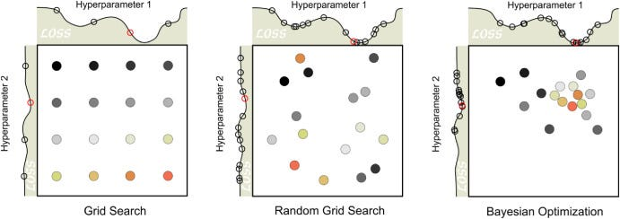
Hyperparameter optimization
https://pub.towardsai.net/optimizing-machine-learning-models-a-deep-dive-into-hyperparameter-tuning-techniques-3cf90771508f

Slide 24
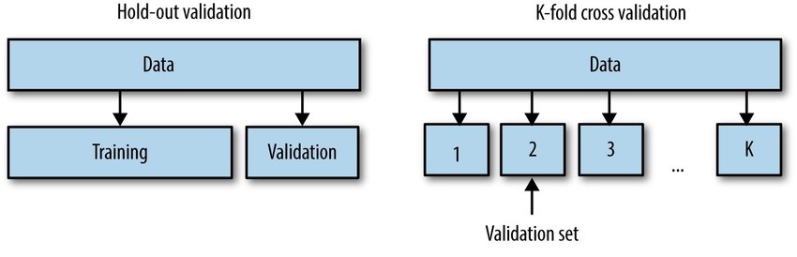
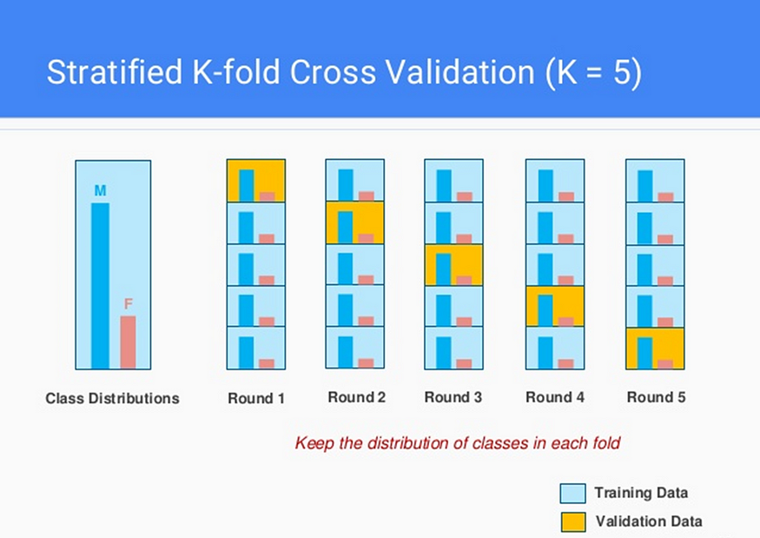
Cross-validation
Stratified K-fold cross validation
http://dx.doi.org/10.13140/RG.2.2.16776.26885
https://medium.com/@ompramod9921/cross-validation-623620ff84c2

Slide 25
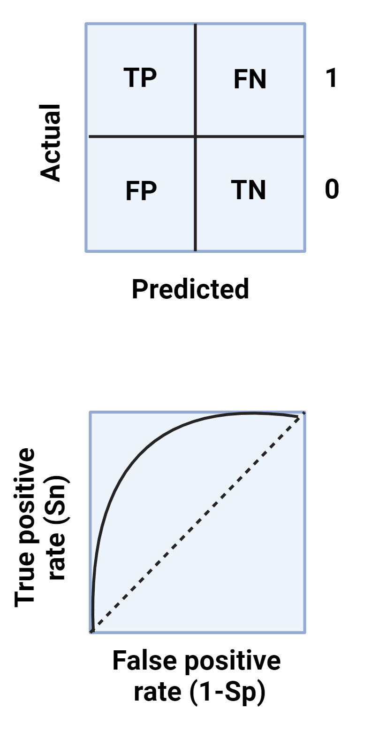
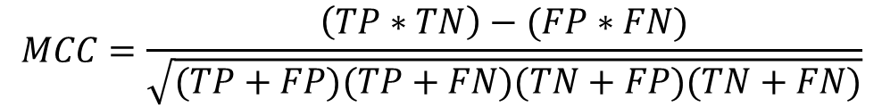
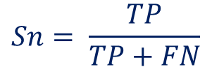
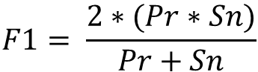
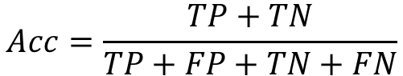
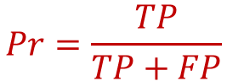
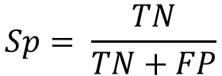
Metrics for classification
$$Pr=\frac{TP}{TP+FP}$$
$$F1= \frac{2∗(Pr∗Sn)}{Pr+Sn}$$
$$Sn= \frac{TP}{TP+FN}$$
$$Sp= \frac{TN}{TN+FP}$$
AUROC
$$Acc=\frac{TP+TN}{TP+FP+TN+FN}$$
$$MCC=\frac{\left(TP∗TN\right)−(FP∗FN)}{\sqrt{(TP+FP)(TP+FN)(TN+FP)(TN+FN)}}$$

Slide 26
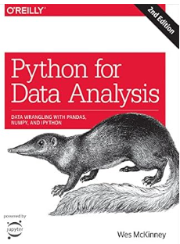
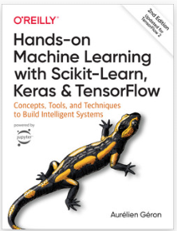
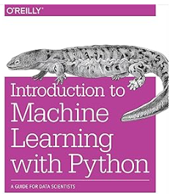
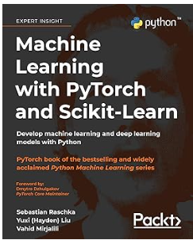
Recommended books
Can be downloaded in Anna’s archive (for educational purposes): https://annas-archive.org

Slide 27
Machine Learning
Prelab 1

Slide 28
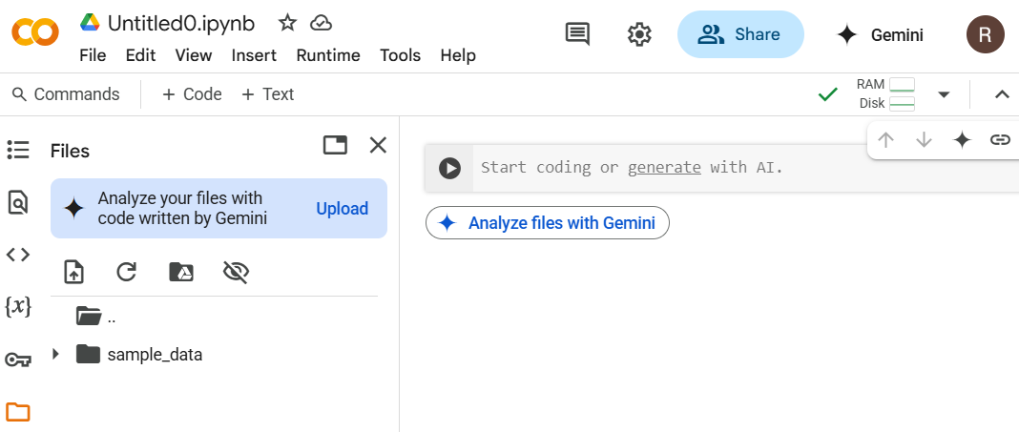
We will be using Google Colaboratory

Slide 29
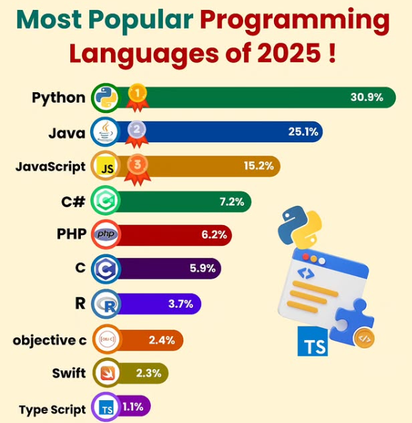


Slide 30
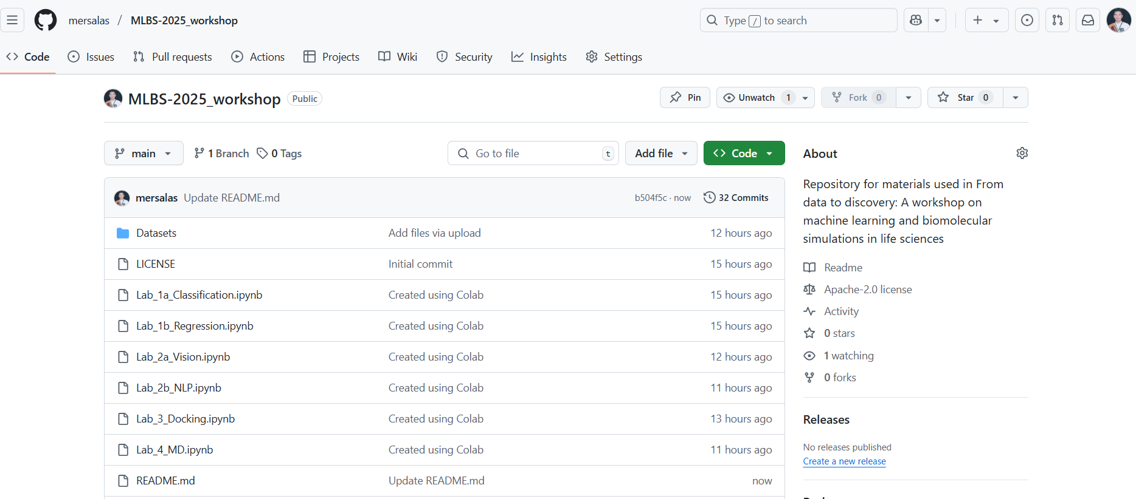
Link to materials: https://github.com/mersalas/MLBS-2025_workshop.git

